Slide 1
Agent Support Program
Presented by: Haley Campbell, Account Executive

Slide 2
What is the Agent Support Program?
Personalized Retention Service

Slide 3
What is the Agent Support Program?
Personalized Retention Service
Available for about 1/3 of your clients

Slide 4
What is the Agent Support Program?
Personalized Retention Service
Available for about 1/3 of your clients
Costs you and your clients nothing

Slide 5
What is ADS?
Industry Expertise Since 2002
Diabetes supply pharmacy that works directly with Medicare agents
Nationally accredited Medicare home delivery pharmacy and DME provider specializing in diabetes management supplies
Have been supporting agents and their members for over 20 years

Slide 6
Who am I?
Account Executive and dedicated resource for you
Specialize in Medicare coverage of diabetes supplies
Focus on providing agents with sales and retention support for clients living with diabetes

Slide 7
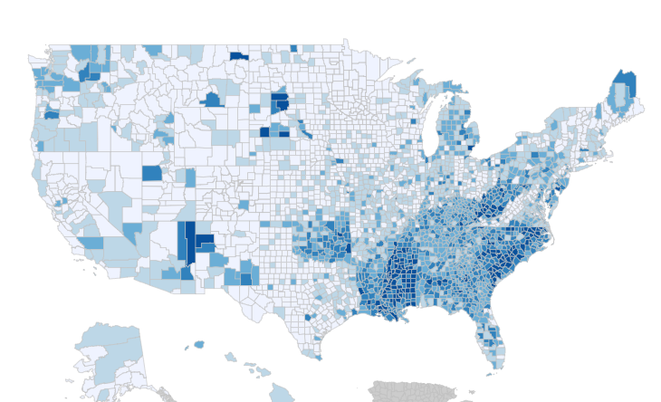
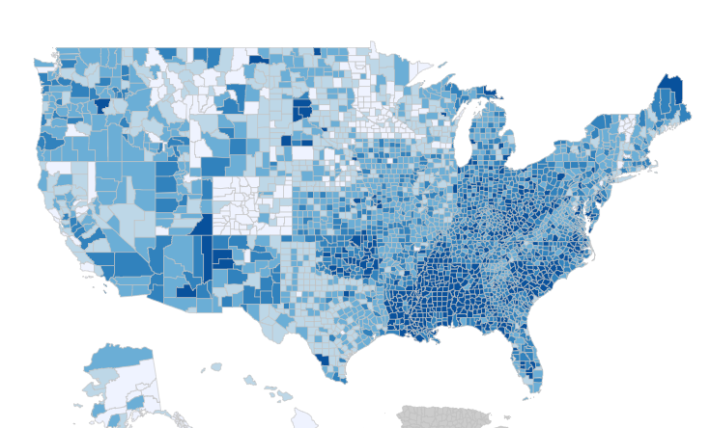
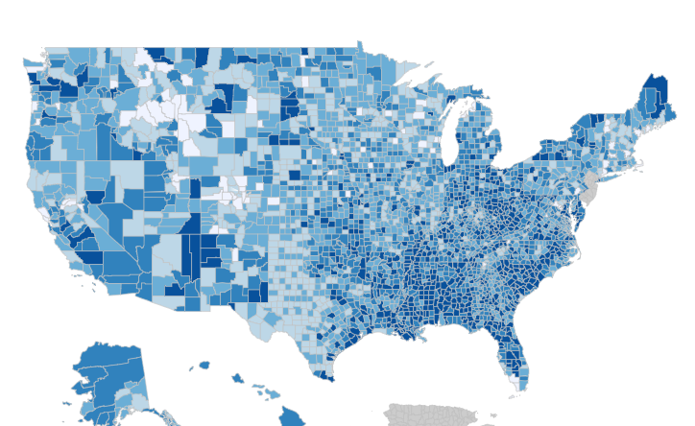
Which of your clients have diabetes?
Diagnosed Diabetes
Total, Adults Aged 20+ Years, 2006-2019³
2006
2012
2019
Approximately 1 in 3 Medicare beneficiaries have diabetes¹
65 years or older: 26.4 million people aged 65+ (48.8%) have prediabetes²
Data Source:
¹https://www.cdc.gov/diabetes/library/reports/reportcard/national-state-diabetes-trends.html
¹https://www.cdc.gov/diabetes/data/statistics-report/index.html
Notes:
Alternate slide on stats (email CDC bullets) – COVID concerns on diabetes prevalence increases (At-risk)

Slide 8
Which of your clients have diabetes?
Commonly Prescribed Diabetes Medications
Oral
metformin
glimepiride
glyburide
Jardiance
Farxiga
Insulin
Humalog
Novolog
Lantus
Levemir
Non-insulin injectable
Ozempic
Trulicity
Victoza
Data Source:
¹https://www.cdc.gov/diabetes/library/reports/reportcard/national-state-diabetes-trends.html
¹https://www.cdc.gov/diabetes/data/statistics-report/index.html
Notes:
Alternate slide on stats (email CDC bullets) – COVID concerns on diabetes prevalence increases (At-risk)

Slide 9
What does that mean?
We can provide personalized retention support to about 1/3 of your book of business

Slide 10
What does that mean?
We can provide personalized retention support to about 1/3 of your book of business
And it costs you nothing

Slide 11
Which supplies do you provide to my clients?

Slide 12
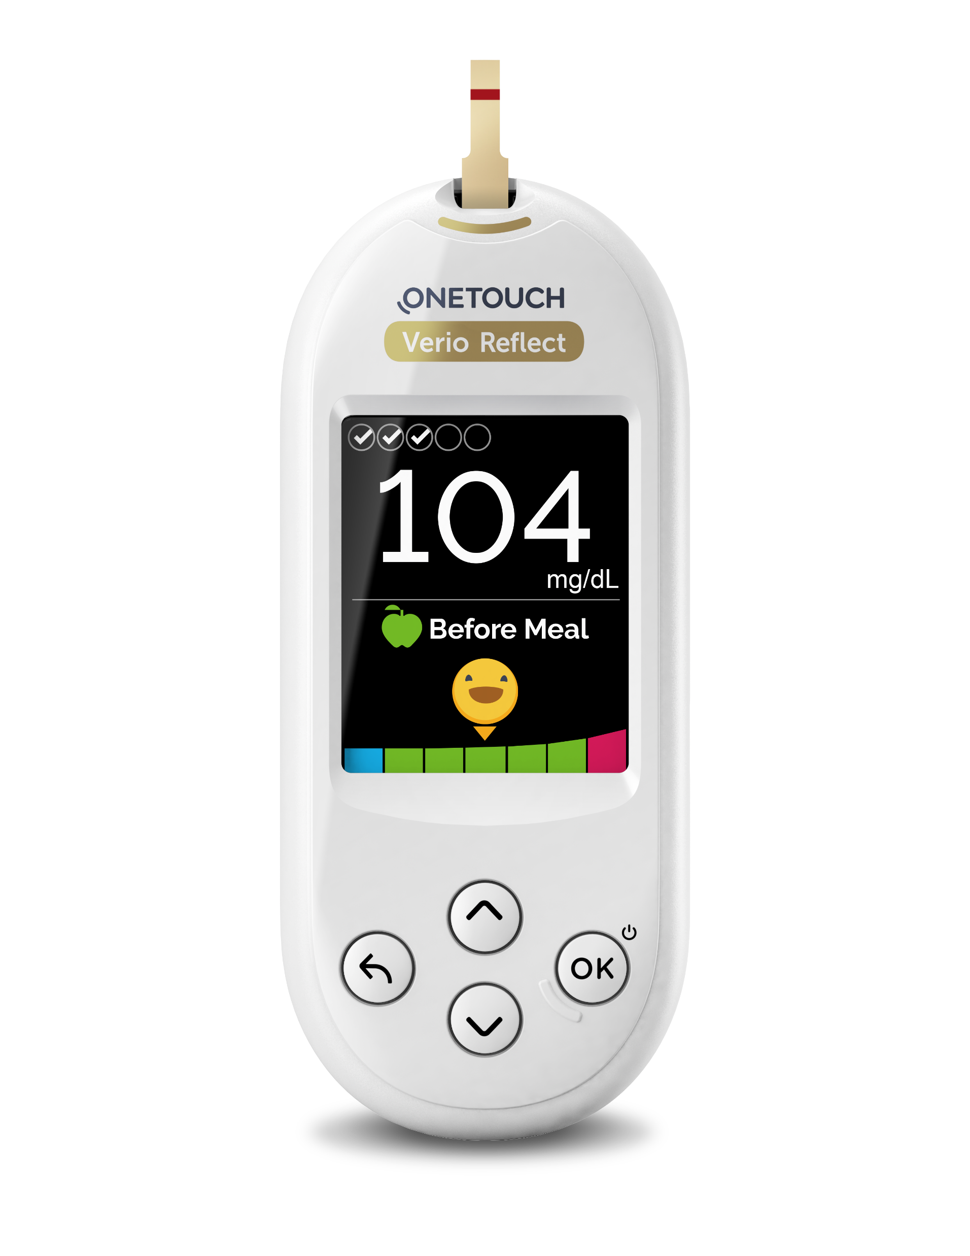
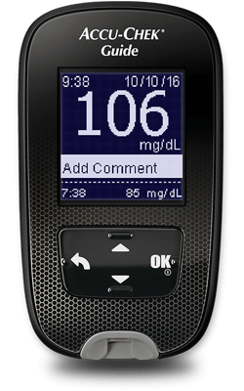
Blood Glucose Meters (BGM)
*Available glucometers based on plan formularies
¹Available as formulary exception for PUMP users

Slide 13
Blood Glucose Meters (BGM)
Blood Glucose Meter
Test Strips
Lancets
Lancing Device
Control Solution
*Available glucometers based on plan formularies
¹Available as formulary exception for PUMP users

Slide 14
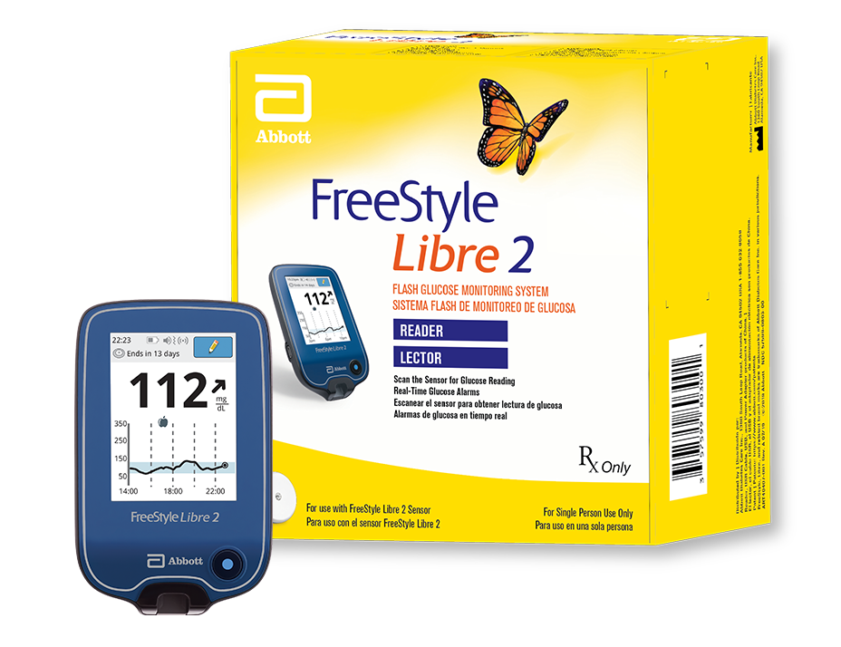
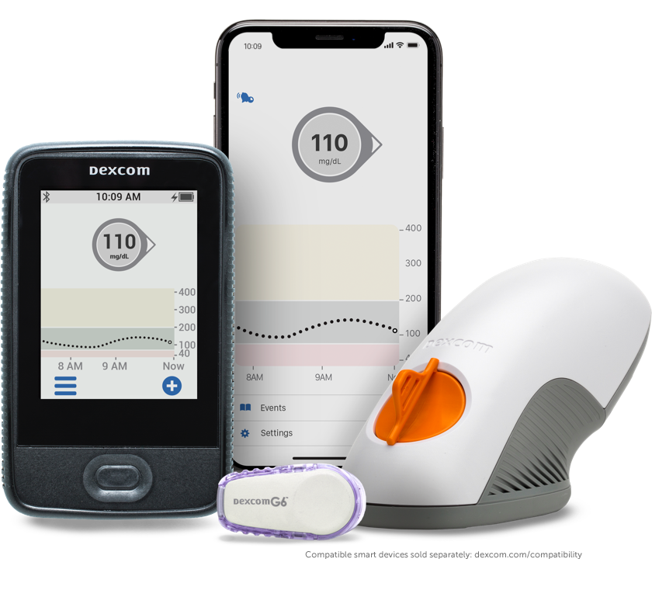
Continuous Glucose Monitors (CGM)
FreeStyle Libre 2
Dexcom G6
Notes:
FreeStyle Neo is available for Libre 2 users

Slide 15
Continuous Glucose Monitors (CGM)
FreeStyle Libre 2
Dexcom G6
ADS is the #1 national distributor for new Libre patients
Access to the latest CGMs on the market are often only available from specialized in-network DME providers like ADS
ADS confirms coverage with client prior to shipping so they are aware of their out-of-pocket responsibilities if applicable*
*Coverage only available for on-insulin clients in accordance with current Medicare guidelines.
Notes:
FreeStyle Neo is available for Libre 2 users

Slide 16
Continuous Glucose Monitors (CGM)
As of today, the Freestyle Libre 3 is not yet covered by Medicare
The Dexcom G7 just received Medicare approval early 2023
*Coverage only available for on-insulin clients in accordance with current Medicare guidelines.
Notes:
FreeStyle Neo is available for Libre 2 users

Slide 17
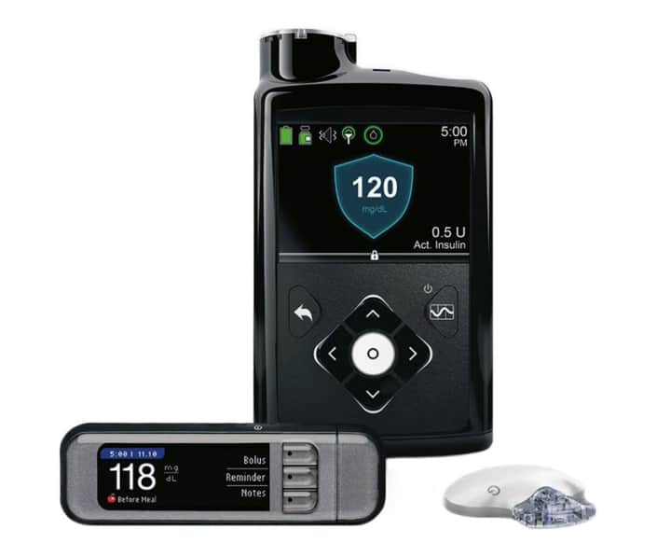
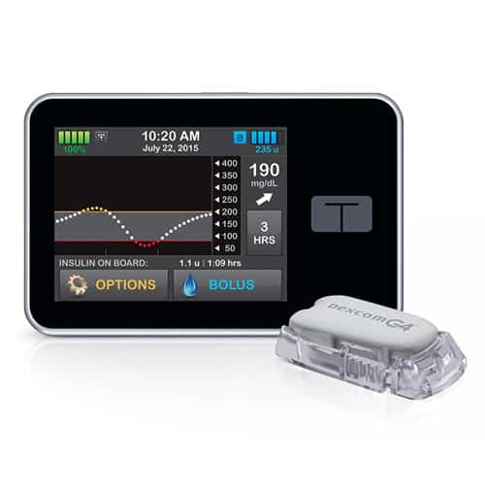
Insulin Pumps & Supplies

Slide 18
Insulin Pumps & Supplies
Medtronic & Tandem Pumps
Infusion Sets
Reservoirs/Cartridges
*Infusion sets and reservoirs are available in multiple sizes to fit the client’s preferences

Slide 19
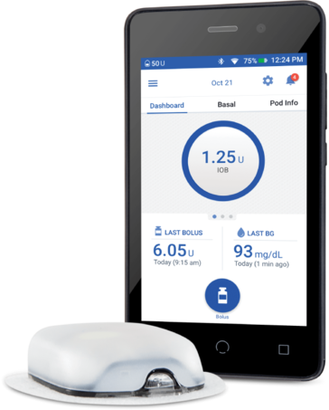
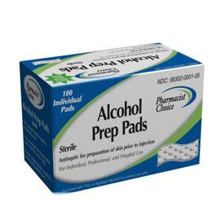
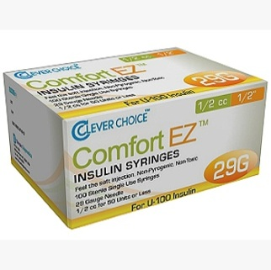
Part D Items
*Syringes and pen needles are available in multiple sizes to fit the client’s preferences

Slide 20
Part D Items
Omnipod Dash/5
Insulin syringes/pen needles
Alcohol wipes
*Syringes and pen needles are available in multiple sizes to fit the client’s preferences

Slide 21
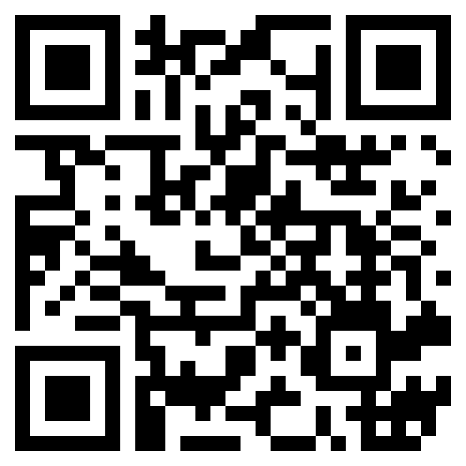
How Can I Take Advantage Myself?
The top-performing agents I work with all leverage ADS services the same way:
They consistently check if their clients have diabetes
They send their client’s contact info to me at point of sale using my secure “Refer A Client” link
Use your mobile phone or computer
OR use QRC code
https://www.northcoastmed.com/haley-campbell/
OR call (760)330-0049
OR Email HCampbell@northcoastmed.com
That’s it!
Notes:
Haley Campbell

Slide 22
What Happens Next?
My team will:
Call your client on your behalf (by referencing you directly by name) to set them up for home delivery
My team calls from one specific number. Have clients save our phone number on their phone (760) 827-6243!
Obtain a prescription from their doctor/prior authorization as required
Verify their coverage details to determine their lowest-cost option for supplies
Ship supplies directly to the client’s door with free shipping

Slide 23
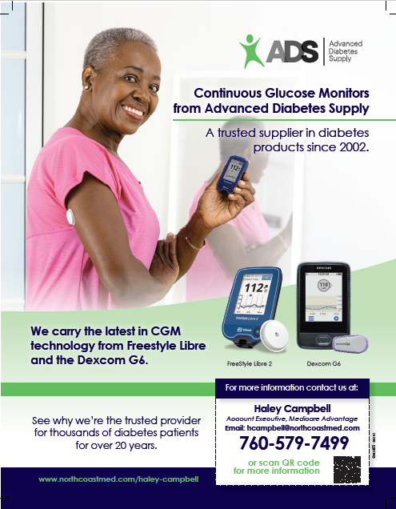
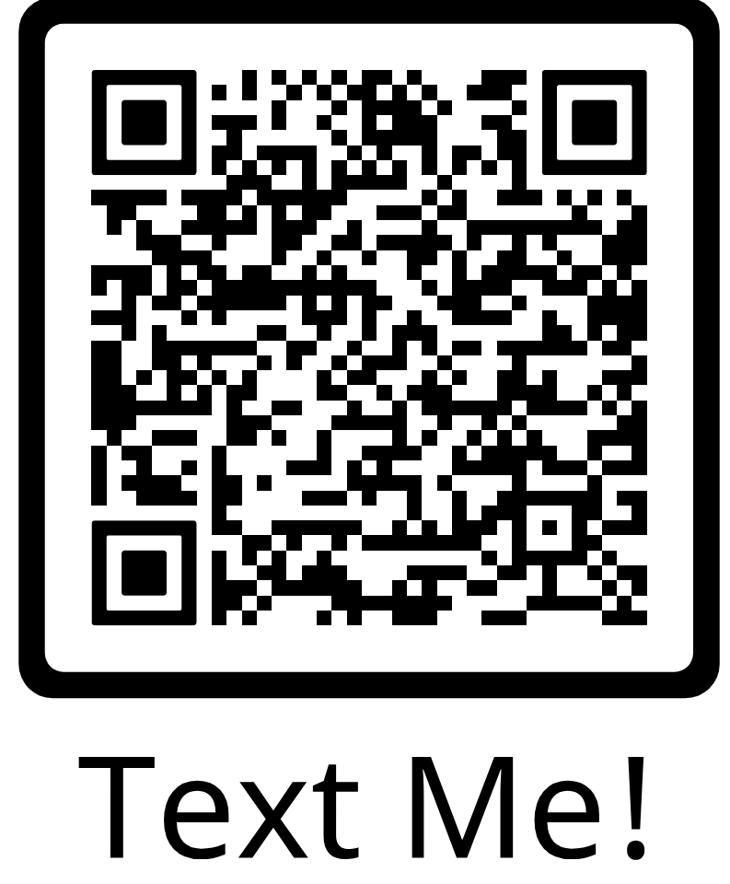
More before I go: No-Cost Marketing Support
Magnets with ADS & Broker contact information
Sample testing kits
Diabetes informational kits with product & disease state FAQs
Text or call me for Marketing support

Slide 24
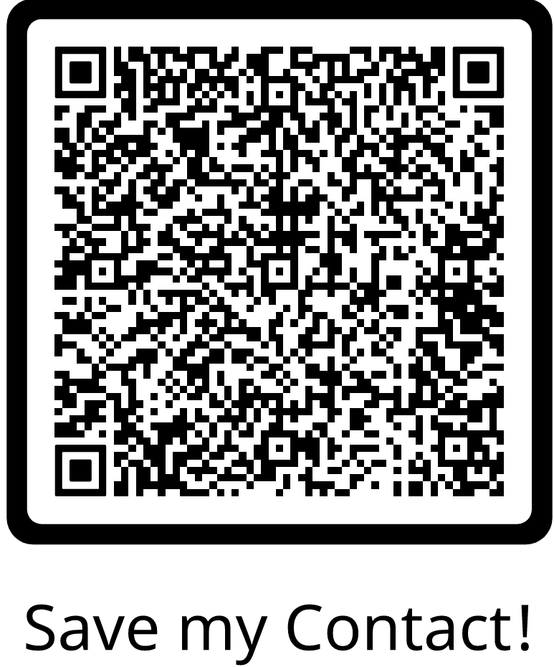
Contact Information
Haley Campbell
Cell: (760)330-0049
Text Only: (760)827-6243
Direct: (760)579-7499
Toll-Free: (877)868-9856
hcampbell@northcoastmed.com
Advanced Diabetes Supply Corporate Address
2544 Campbell Place, Suite 150
Carlsbad, CA 92009
Notes:
Haley Campbell

