Slide 1
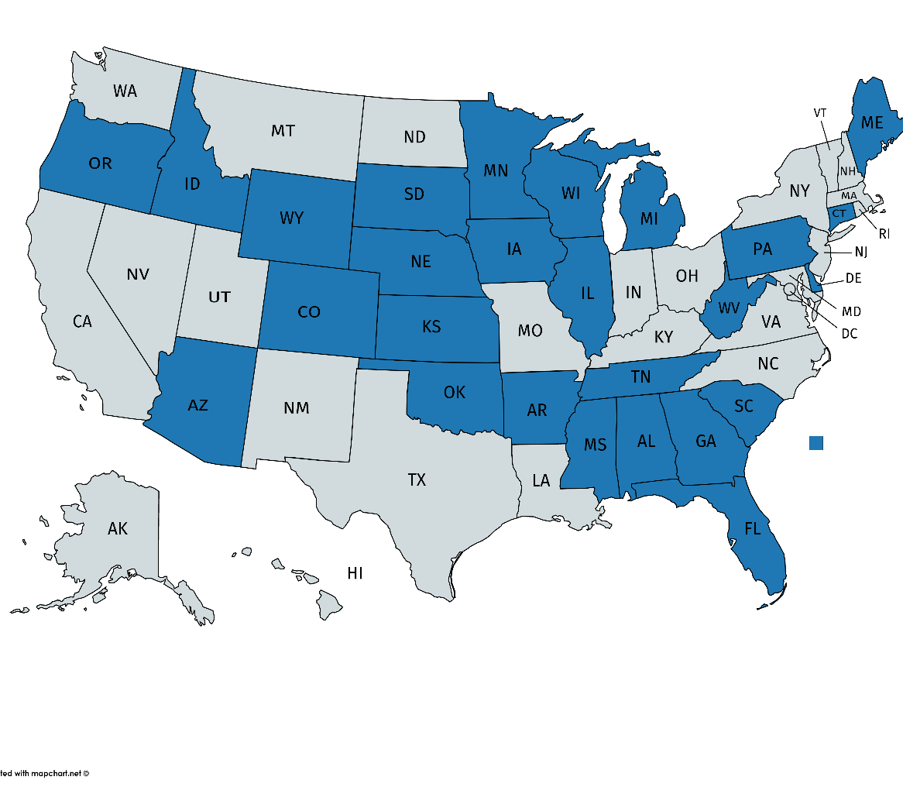
Coming Soon to Your State!
Now Available: AL, AR, AZ, CO, CT, DE, FL, GA, IA, ID, IL, KS, ME, MI, MN, MS, NE, OK, OR, PA, SC, SD, TN, WI, WV and
WY!
Launching 6/21: LA, MO, ND,
NM, NV and UT
Launching 7/19: TX, KY and OH
(More States to come for 7/19
Launch!)

Slide 2
Prime DVH: Monthly Premiums (Standard)
Issue Age | $1,000 Annual Benefit | $1,500 Annual Benefit | $2,000 Annual Benefit
0 – 17 | $20.00 | $25.00 | $31.00
18 – 25 | $22.00 | $28.00 | $33.00
26 – 40 | $25.00 | $30.00 | $39.00
41 – 65 | $29.00 | $36.00 | $46.00
66 – 90 | $38.00 | $47.00 | $60.00
Issue age premiums- rates that stay the same as your client ages (rates may vary in some states)
Notes:
ok

Slide 3
Prime DVH: Monthly Premiums (CO Only)
Issue Age | $1,000 Annual Benefit | $1,500 Annual Benefit | $2,000 Annual Benefit
0 – 17 | $17.00 | $25.00 | $31.00
18 – 25 | $19.00 | $28.00 | $33.00
26 – 40 | $21.00 | $30.00 | $39.00
41 – 65 | $25.00 | $36.00 | $46.00
66 – 90 | $32.00 | $47.00 | $60.00
Issue age premiums- rates that stay the same as your client ages (rates may vary in some states)
Notes:
ok

Slide 4
Prime DVH: Monthly Premiums (FL Only)
Issue Age | $1,000 Annual Benefit | $1,500 Annual Benefit | $2,000 Annual Benefit
0 – 17 | $17.00 | $24.00 | $30.00
18 – 25 | $19.00 | $27.00 | $32.00
26 – 40 | $21.00 | $29.00 | $38.00
41 – 65 | $25.00 | $33.00 | $44.00
66 – 90 | $32.00 | $44.00 | $57.00
Issue age premiums- rates that stay the same as your client ages (rates may vary in some states)
Notes:
ok

Slide 5
Prime DVH: Monthly Premiums (MN Only)
Issue Age | $1,000 Annual Benefit | $1,500 Annual Benefit | $2,000 Annual Benefit
0 – 17 | $17.00 | $25.00 | $31.00
18 – 25 | $19.00 | $28.00 | $33.00
26 – 40 | $21.00 | $30.00 | $39.00
41 – 65 | $25.00 | $36.00 | $46.00
66 – 90 | $32.00 | $47.00 | $60.00
Issue age premiums- rates that stay the same as your client ages (rates may vary in some states)
Notes:
ok

