Slide 1
Annuity Training
MJ

Slide 2
Back to Basics
Fixed Indexed Annuities
Fixed Account
Indexed accounts
Safety and Fair Rate of Return
Compounding Interest
Tax Deferral

Slide 3
American Equity Choice Series
Issue Ages
18-85 for Choice 6 and 8
18-80 for Choice 10
Liquidity
10% annually after yr. one
Nursing Care/Terminal Illness Riders under age 75
Full death benefit at death of Owner or Annuitant
Surrender Charge Period
6, 8 and 10 Years

Slide 4
Choice Series 6

Slide 5
Choice Series 8

Slide 6
Choice Series 10

Slide 7
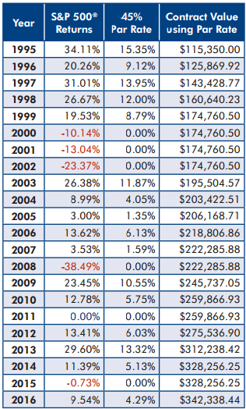
100,000 Initial Premium
Annual Point to Point
S&P 500
45% Participation Rate
5.9% Average Return on 45% index
Can go up 5% on participation if they take an MVA

Slide 8
Why Focus on the 45%?
The majority of annuities in the market us a risk controlled index with a spread
Harder to explain
Return on majority of risk controlled indexes have performed very poorly
After factoring in the spread, many years have resulted in a 0% gain for clients

Slide 9
Why Focus on the 45%?
Examples of risk controlled indexes
S & P 500 risk control 10%
S & P 500 risk control 5%
Barclays Armour II Volatility control Index
Morgan Stanley Volnet
Security Benefit BNP Paribus

Slide 10
Why Focus on the 45%?
Trend with annuity companies is to pitch high participation with the volatility control indexes
They have performed poorly compared to the S & P
Average return over last 5 years for risk control indexes is 4%

Slide 11
Why Focus on the 45%?
4% average return with an average spread of 2%
Most plans are on a 2 year point to point as well
Client get little return and will forget why they did not get any interest after year 1

Slide 12
Optional Lifetime Income
Provides a Guaranteed Lifetime Income Benefit
Option 1 Guaranteed IAV Growth
Option 2 Guaranteed IAV Growth + Wellbeing Benefit
Option 3 Indexing Income
Wellbeing benefit is an income doubled rider
Indexing income is return x 3

Slide 13
Income Rider Options
Option 1- 6.0% roll-up rate for 0.90% Annual Fee
Option 2- 6.0% roll-up rate w/ Wellbeing Benefit for 1.00% Annual Fee
Option 3- IAV Multiplier times the contract value rate-of-return for 0.90% Annual Fee

Slide 14
Annuity Leads
Exclusive, Scrubbed and Verified
25-30 Minutes spent verifying each lead
TV, Radio, Direct Mail, Internet
$200.00 per Lead

Slide 15
Next Steps
Email Lisa@croweandassociates.com to get contracted
Call Christy Sparks with your next case for a full illustration
Csparks@GordonMarketing.com
317-776-6770 xt.374

